Slide 1







TEAM NAME: MissFit Mannequin
COLLEGE NAME: Sri Venkateswara College of Engineering
PROBLEM STATEMENT: Sketch2Style : AI-Powered Fashion Virtual Try-On System

Slide 2
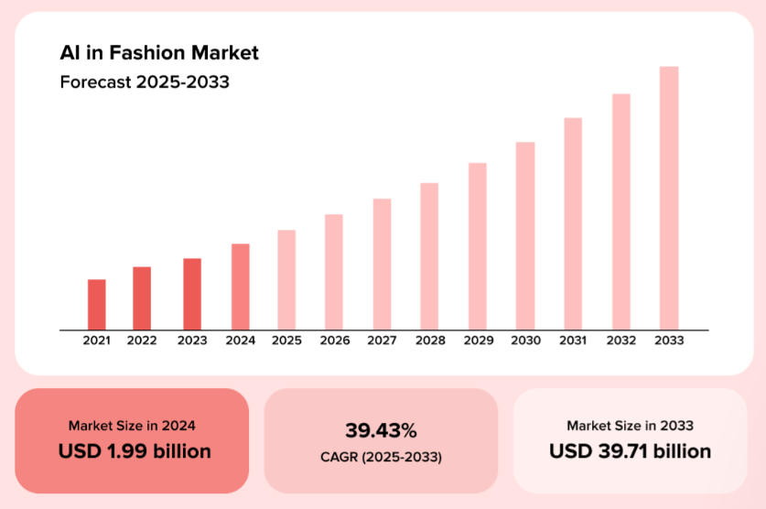

Traditional fashion design involves time-consuming manual processes such as sketch interpretation, fabric visualization, pattern making, and physical prototyping. These steps increase cost, delay production, and limit customization. Additionally, customers cannot accurately visualize how a garment will look on their body before purchase, leading to dissatisfaction and high return rates.
PROBLEM STATEMENT
Forum Of Data Science Engineers
Traditional fashion design involves time-consuming manual processes such as sketch interpretation, fabric visualization, pattern making, and physical prototyping.
These steps increase cost, delay production, and limit customization.
Additionally, customers cannot accurately visualize how a garment will look on their body before purchase, leading to dissatisfaction and high return rates.

Slide 3
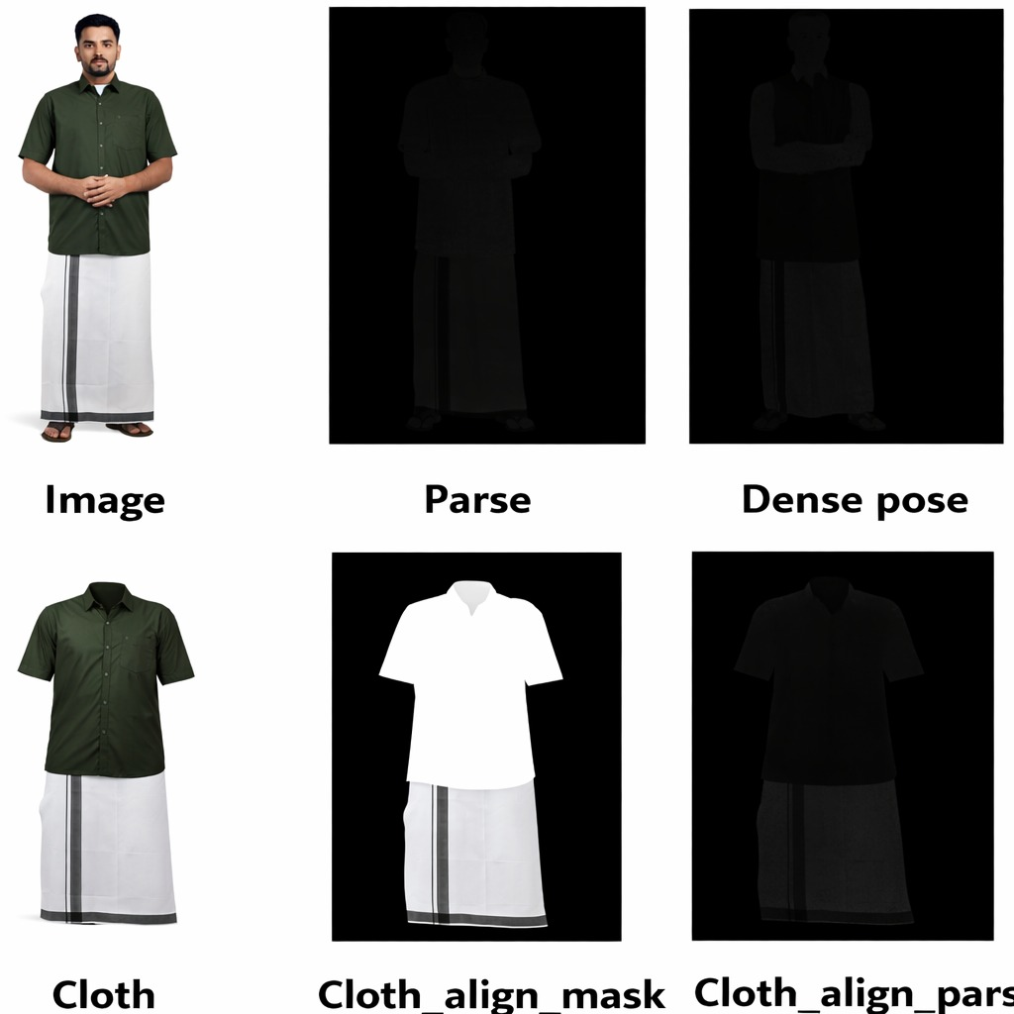
SOLUTION
Develop an AI-based fashion design system that converts hand-drawn sketches into realistic garment images using diffusion models and ControlNet.
Use edge detection and sketch preprocessing to preserve the original design structure.
Integrate pose estimation (MediaPipe/OpenPose) to detect body landmarks.
Implement a virtual try-on module to visualize the generated clothing on the user in real time.
Enable fast design visualization and reduce the need for physical prototypes.
Forum Of Data Science Engineers

Slide 4
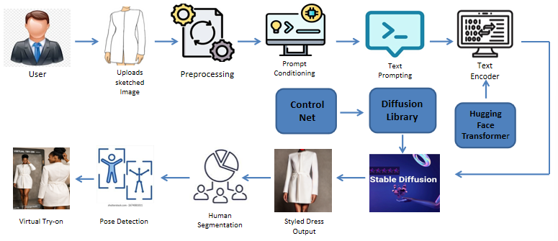
FLOW DIAGRAM
Forum Of Data Science Engineers

Slide 5
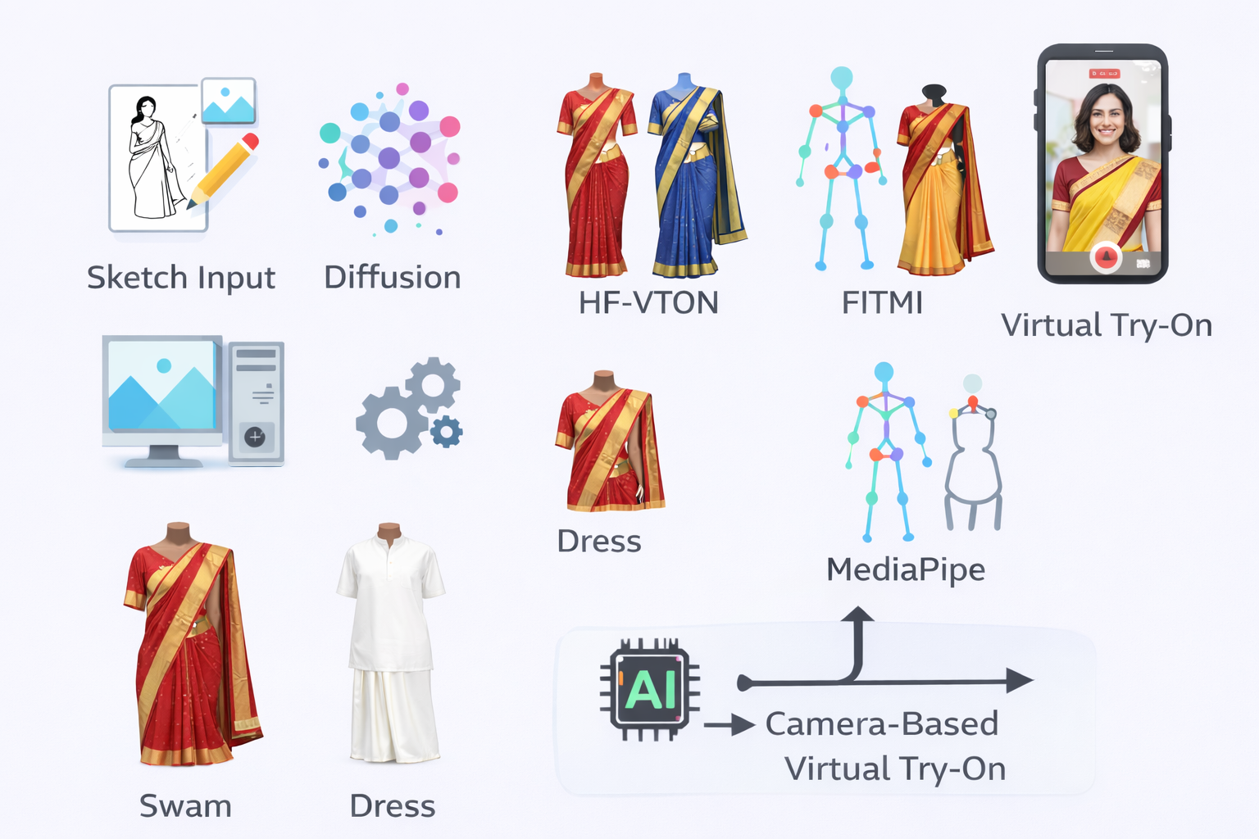
TECHNICAL REQUIREMENTS
Hardware
CPU: Intel i5 / Ryzen 5 or higher
GPU: NVIDIA (for training / real-time inference)
8 GB RAM minimum
Software
Python (3.8+)
PyTorch
Flask / FastAPI
OpenCV, MediaPipe for pose
Diffusion model libraries (e.g., HuggingFace diffusers)
Datasets
Fashion sketch → image pairs (e.g., curated dataset)
Clothing benchmarks (FITMI validation sets)
Forum Of Data Science Engineers

Slide 6
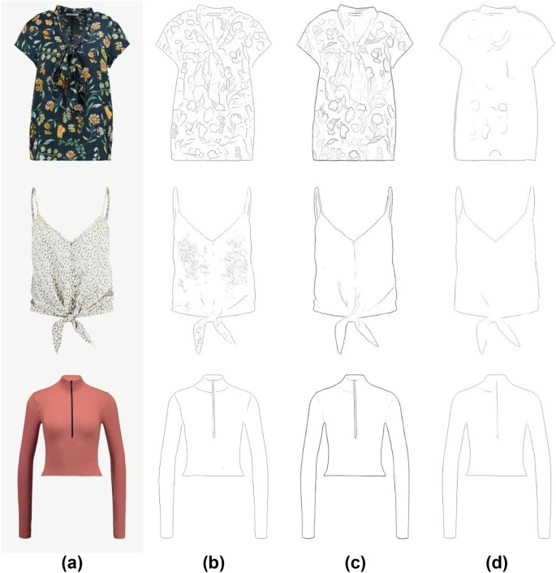
NOVELTY / USE CASE
Combines sketch-to-image garment generation with virtual try-on in a single system.
Uses diffusion-based AI models for high-quality clothing generation.
Allows design visualization directly from sketches without manual garment creation.
Supports real-time user visualization using pose detection.
Forum Of Data Science Engineers
Fashion designers can quickly visualize clothing designs before production.
E-commerce platforms can provide virtual try-on for customers.
Clothing brands can reduce production cost and prototype time.
Customers can see how clothes look on them before buying, reducing return rates.

Slide 7
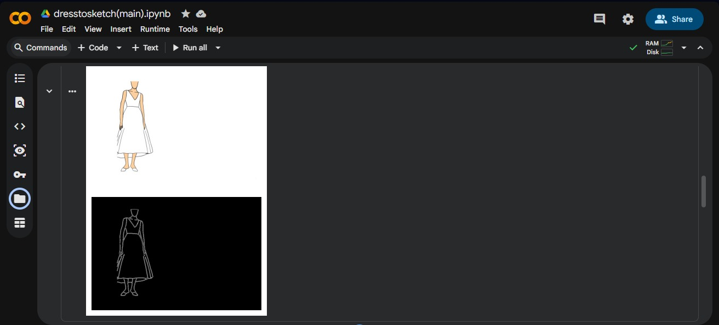
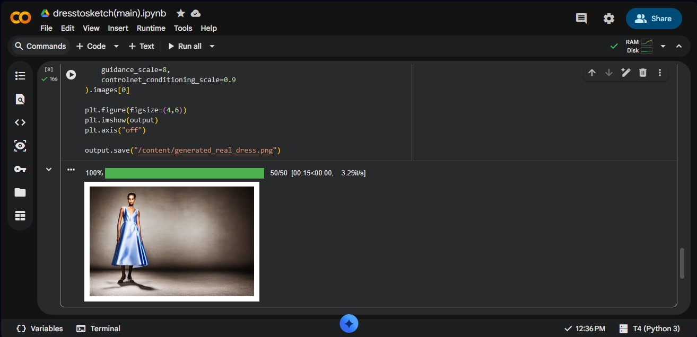
Implementation
Forum Of Data Science Engineers
D E S I G N . D E V E L O P . D E P L O Y

Slide 8



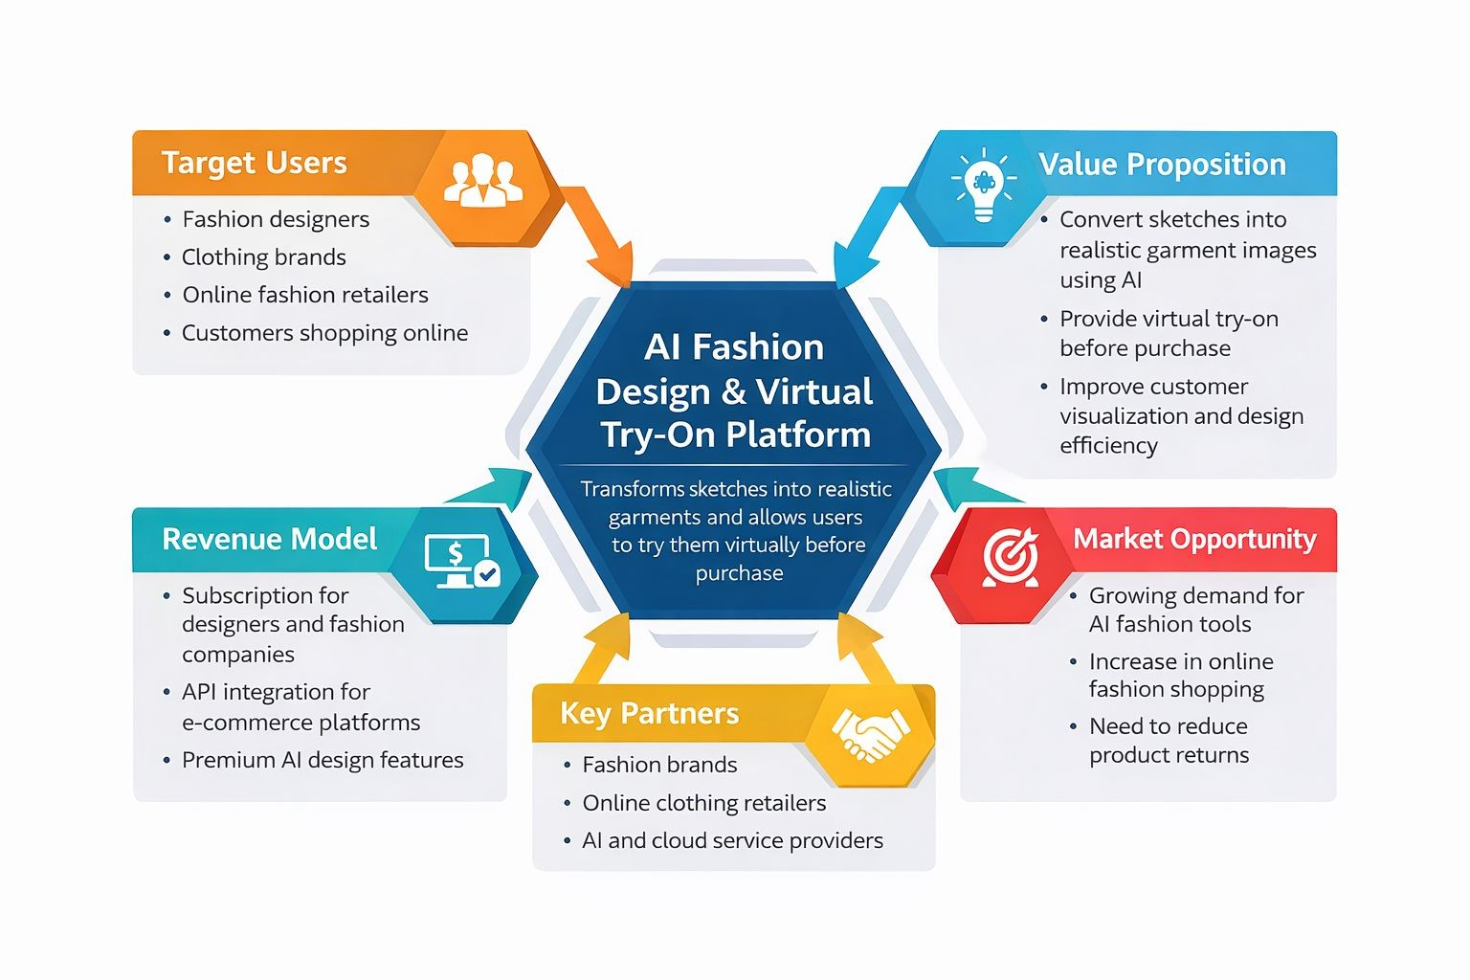
BUSINESS MODEL / TARGET MARKET
Forum Of Data Science Engineers
D E S I G N . D E V E L O P . D E P L O Y

Slide 9
TEAM DETAILS
Forum Of Data Science Engineers
Serial No | Team Members | Department | Register No | Mobile No
01 | Panimalar P | AIDS | 2127220502061 | 9445331197
02 | Priyanka S | AIDS | 2127220502070 | 9940168359
03 | Roshinee BVN | AIDS | 2127220502075 | 9003619690
04 | Varnamalika N | AIDS | 2127220502106 | 9840895841
ROLE
NAME
STREAM/DEPT
YEAR
COLLEGE

